Slide 1
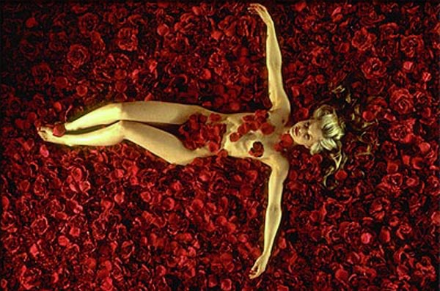
Mise En Scene

Slide 2
Lesson Objectives
By the end of the session you will be able to:
Understand the concept of ‘mise en scene’
Apply the concept to film images

Slide 3
Definition: Mise En Scene
A French term meaning placing on the stage- everything in the scene/shot
Visual information in front of the camera
Communicates essential information to the audience
Made up of 5 elements: Can you guess what they are?

Slide 4
The 5 Elements of Mise en Scene
Each aspect of mise-en-scene has hidden meanings within a film and sends signals to the audience about how we are supposed to feel at a certain point
Settings & Props
Costume, Hair & Make Up
Facial Expressions & Body Language
Lighting & Colour
Positioning of characters/objects within the frame

Slide 5
1. Settings & Props
Settings & Locations play an important part in film-making and are not just ‘backgrounds’
Sets are either built from scratch or a great deal of time is spent to find a setting which already exists
Settings can manipulate an audience by building certain expectations and then taking a different turn
TASK: What settings and props you would find in:
A Science Fiction Film
A Romantic Comedy
A Horror Film

Slide 6
2. Costume, Hair & Make Up
Costume, Hair & Make Up act as an instant indicator to us of a character’s personality, status & job
It tells us immediately whether the film is set in the present and what society/or culture it will centre around,
Certain costumes can signify certain individuals (i.e. black cloak of a vampire, Spiderman’s suit).
What do we understand about the characters in the following slides?

Slide 7
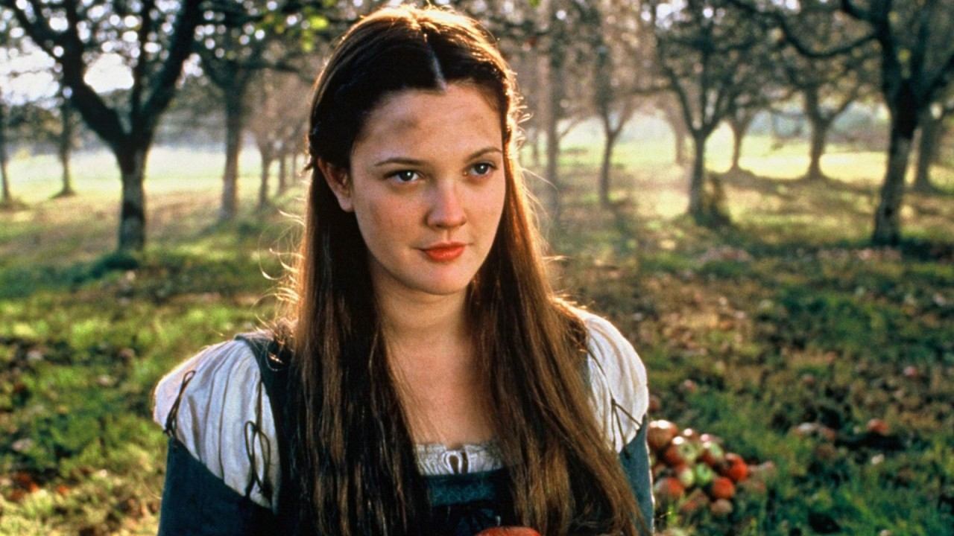

Slide 8
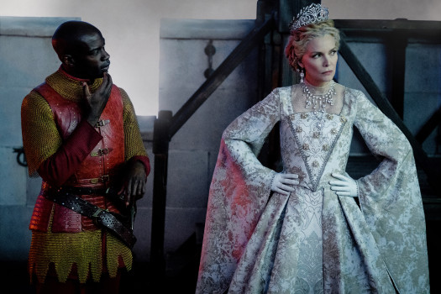

Slide 9
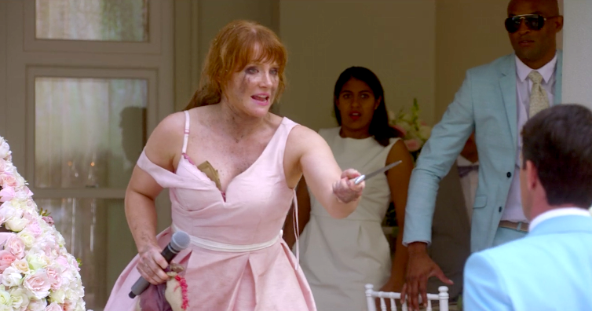

Slide 10
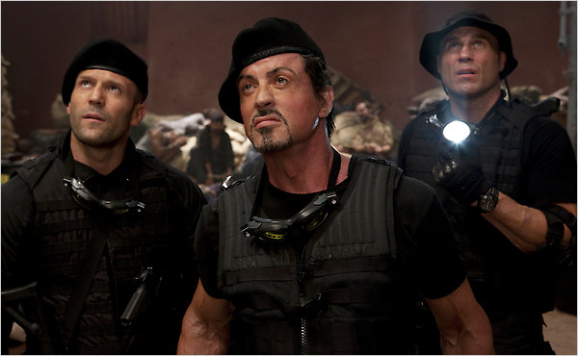

Slide 11
3. Facial Expressions & Body Language
Facial Expressions provide a clear indicator of how someone is feeling
If someone is smiling broadly, we assume they are happy but we may get a different feeling if this is accompanied by scary music
Body Language may also indicate how a character feels towards another character or may reflect the state of their relationship
TASK: What meanings/emotions do the following images convey? And how do they convey them?

Slide 12
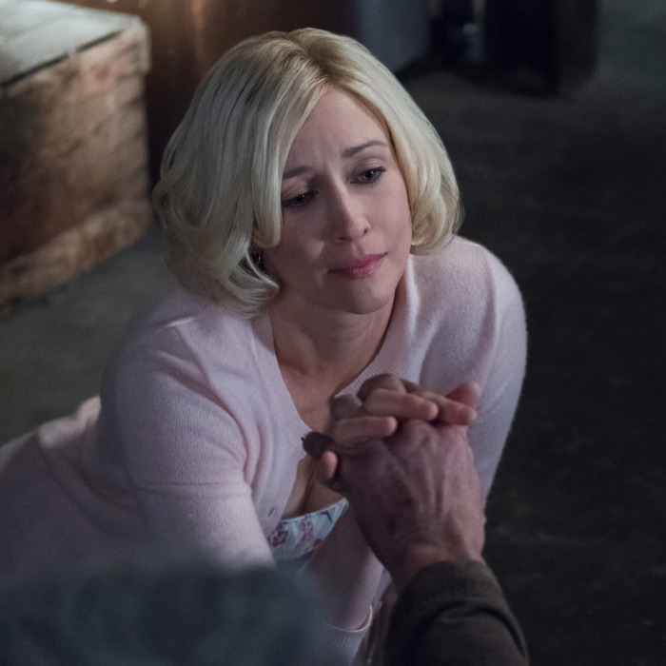

Slide 13
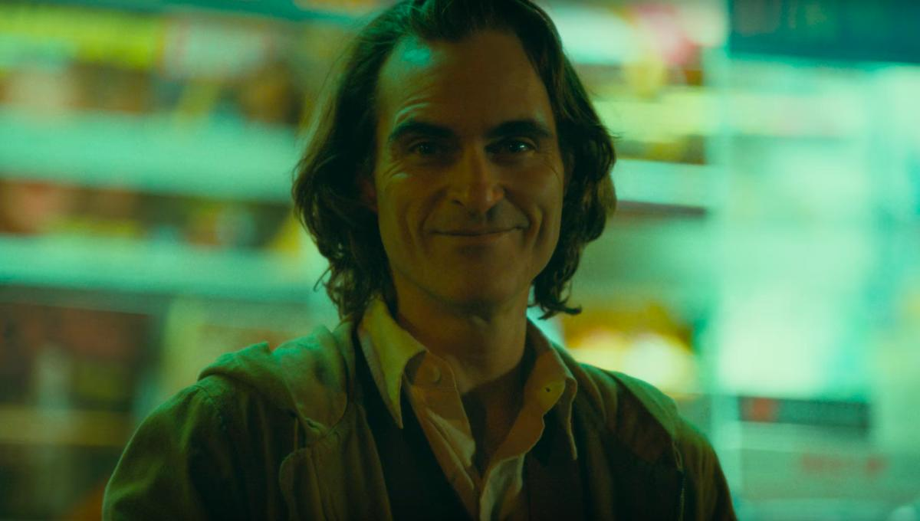

Slide 14
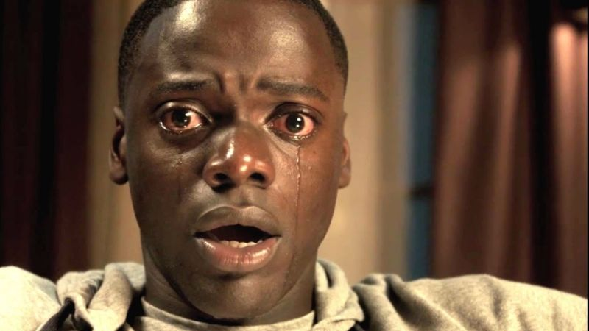

Slide 15
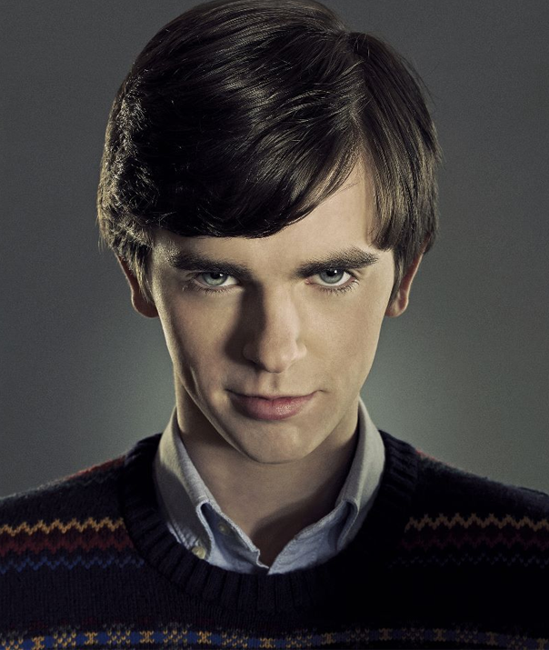

Slide 16
4. Positioning of Characters & Objects within a frame
Positioning within a frame can draw our attention to an important character/object
A film-maker can use positioning to indicate relationships between people
TASK: What does the positioning in the following images reveal about the characters/film:

Slide 17
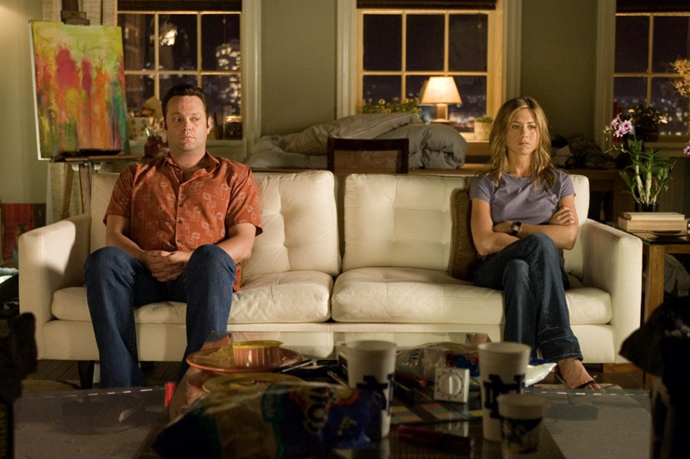

Slide 18
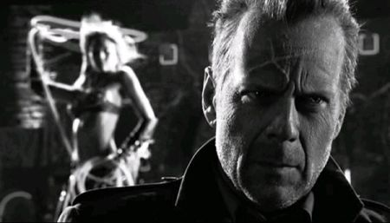

Slide 19
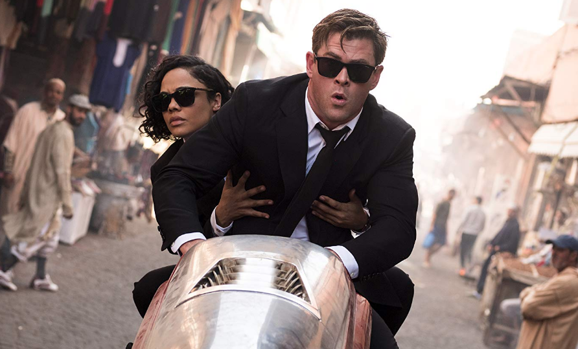

Slide 20
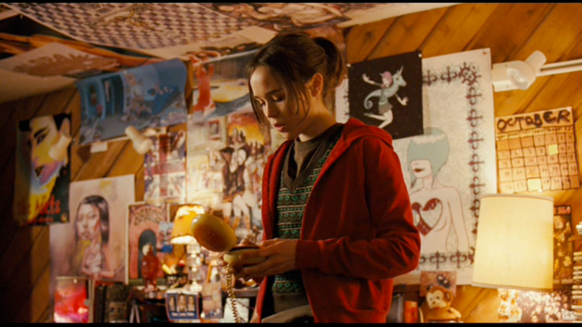

Slide 21
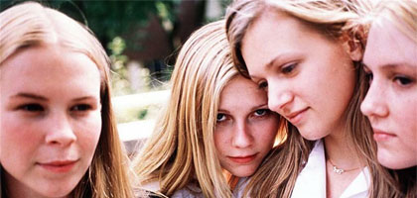
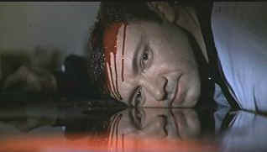
Colour
Colour carries certain connotations which may add meaning to a scene (i.e. Red = Danger/Passion)
Can give a scene a particular look, feel or mood
Can be used for dramatic effect

Slide 22
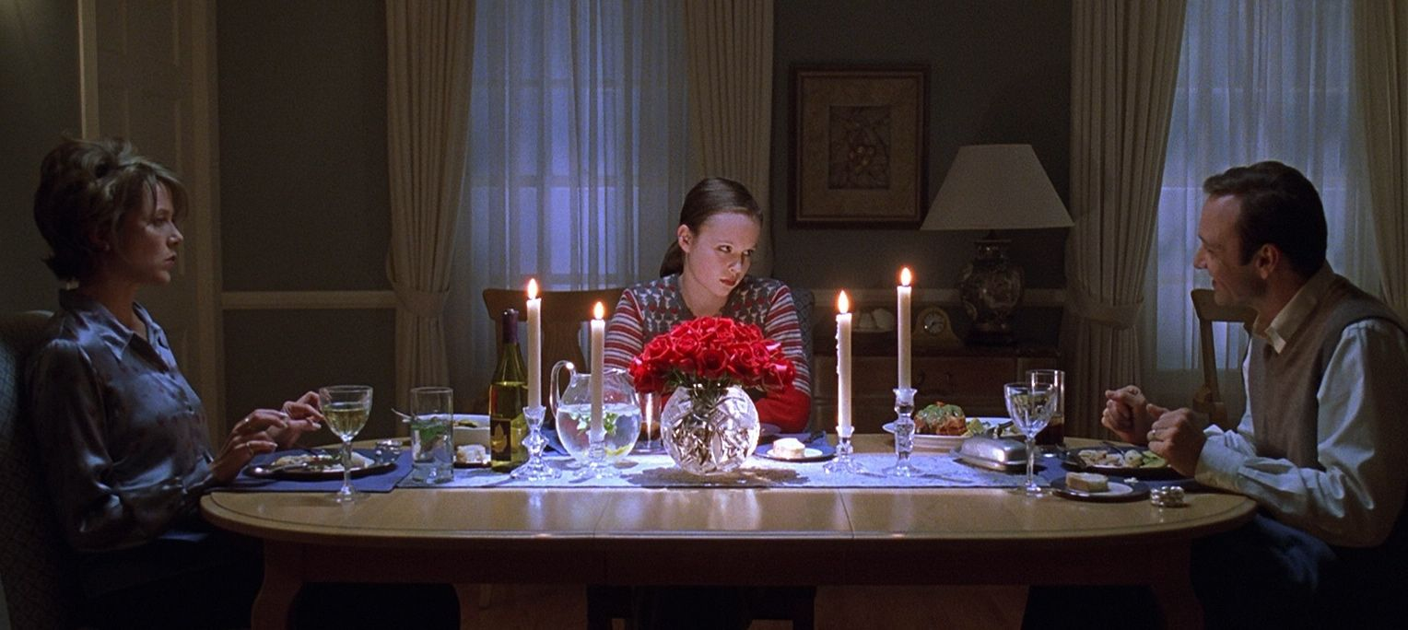
Analysing Mise en Scene

Slide 23
5. Lighting & Colour
Lighting & Colour can be used to achieve a variety of effects:
To highlight important characters or objects within the frame
To make characters look mysterious by shading sections of the face & body
To reflect a characters mental state/hidden emotions (i.e. bright = happy, dark = disturbed, strobe effect = confused

Slide 24
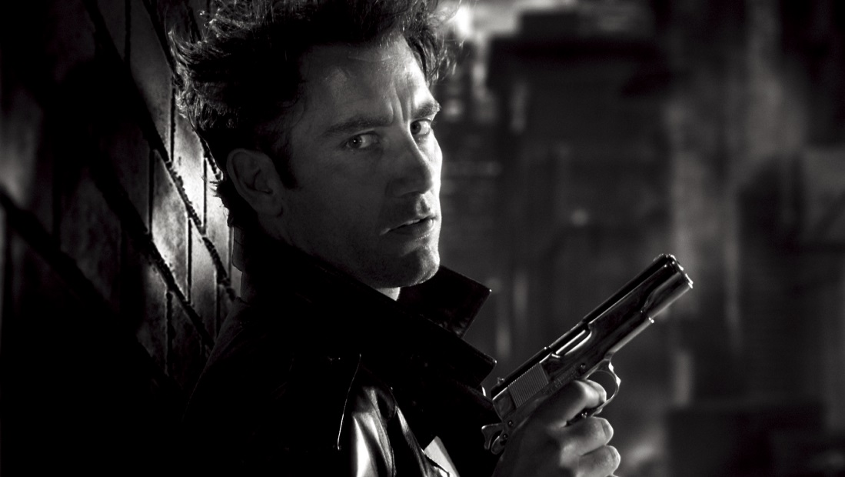
Types of Lighting
LOW KEY LIGHTING:
Created by using only the key & back lights
Produces sharp contrasts of light and dark areas
Deep, distinct shadows/silhouettes are formed
Example: Horror Films

Slide 25
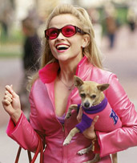
Types of Lighting
HIGH KEY LIGHTING:
More filler lights are used. Lighting is natural and realistic to our eyes
Produces brightly lit sets or a sunny day (right)
Example: Rom-Coms

Slide 26
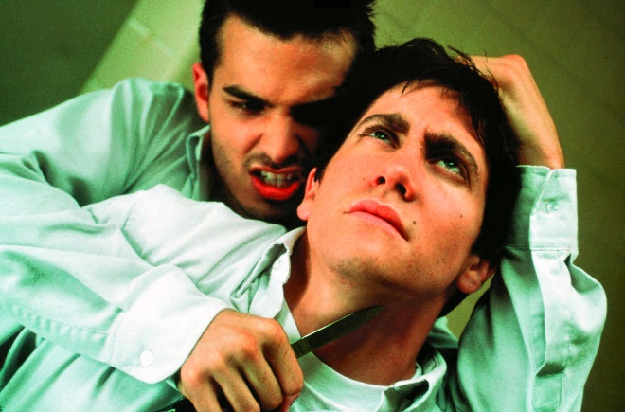
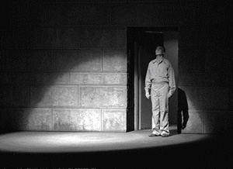
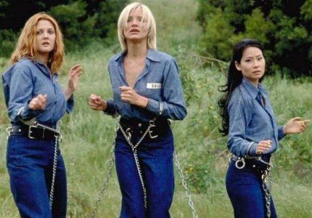
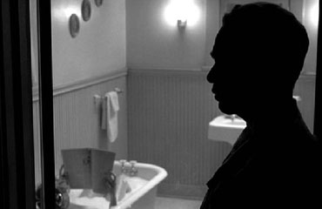
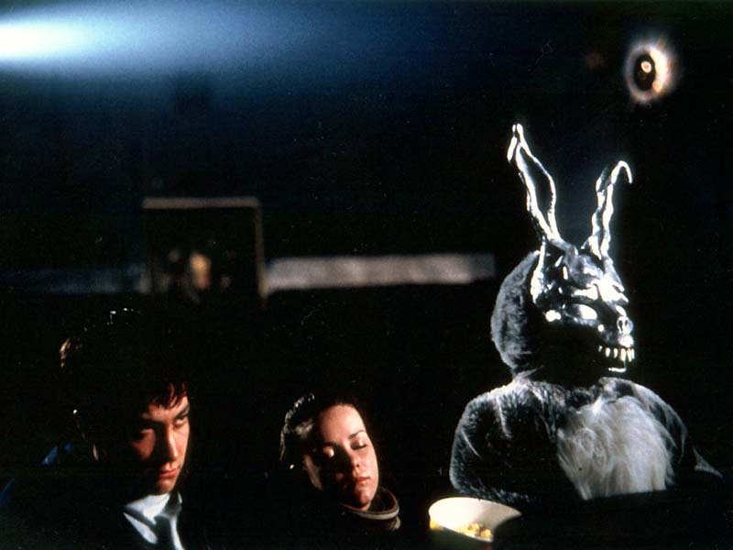
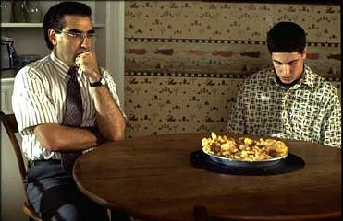
What types of lighting are used in the following images:
A
B
C
D
E
F

Slide 27
TASK: For each image, answer the following questions:
What type of lighting is used in each image (High or Low Key)?
Where are the KEY LIGHTS, FILLER LIGHTS & BACK LIGHTS in each image?
What effects/meanings does the lighting suggest?

Slide 28
BACK
LIGHT
FILLER LIGHTS
KEY LIGHT

Slide 29
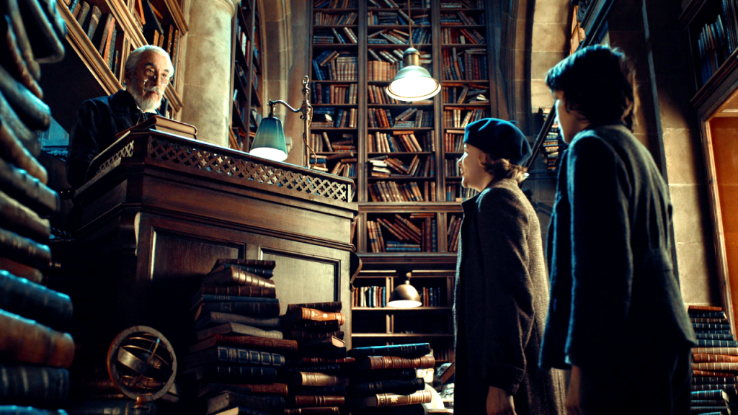

Slide 30
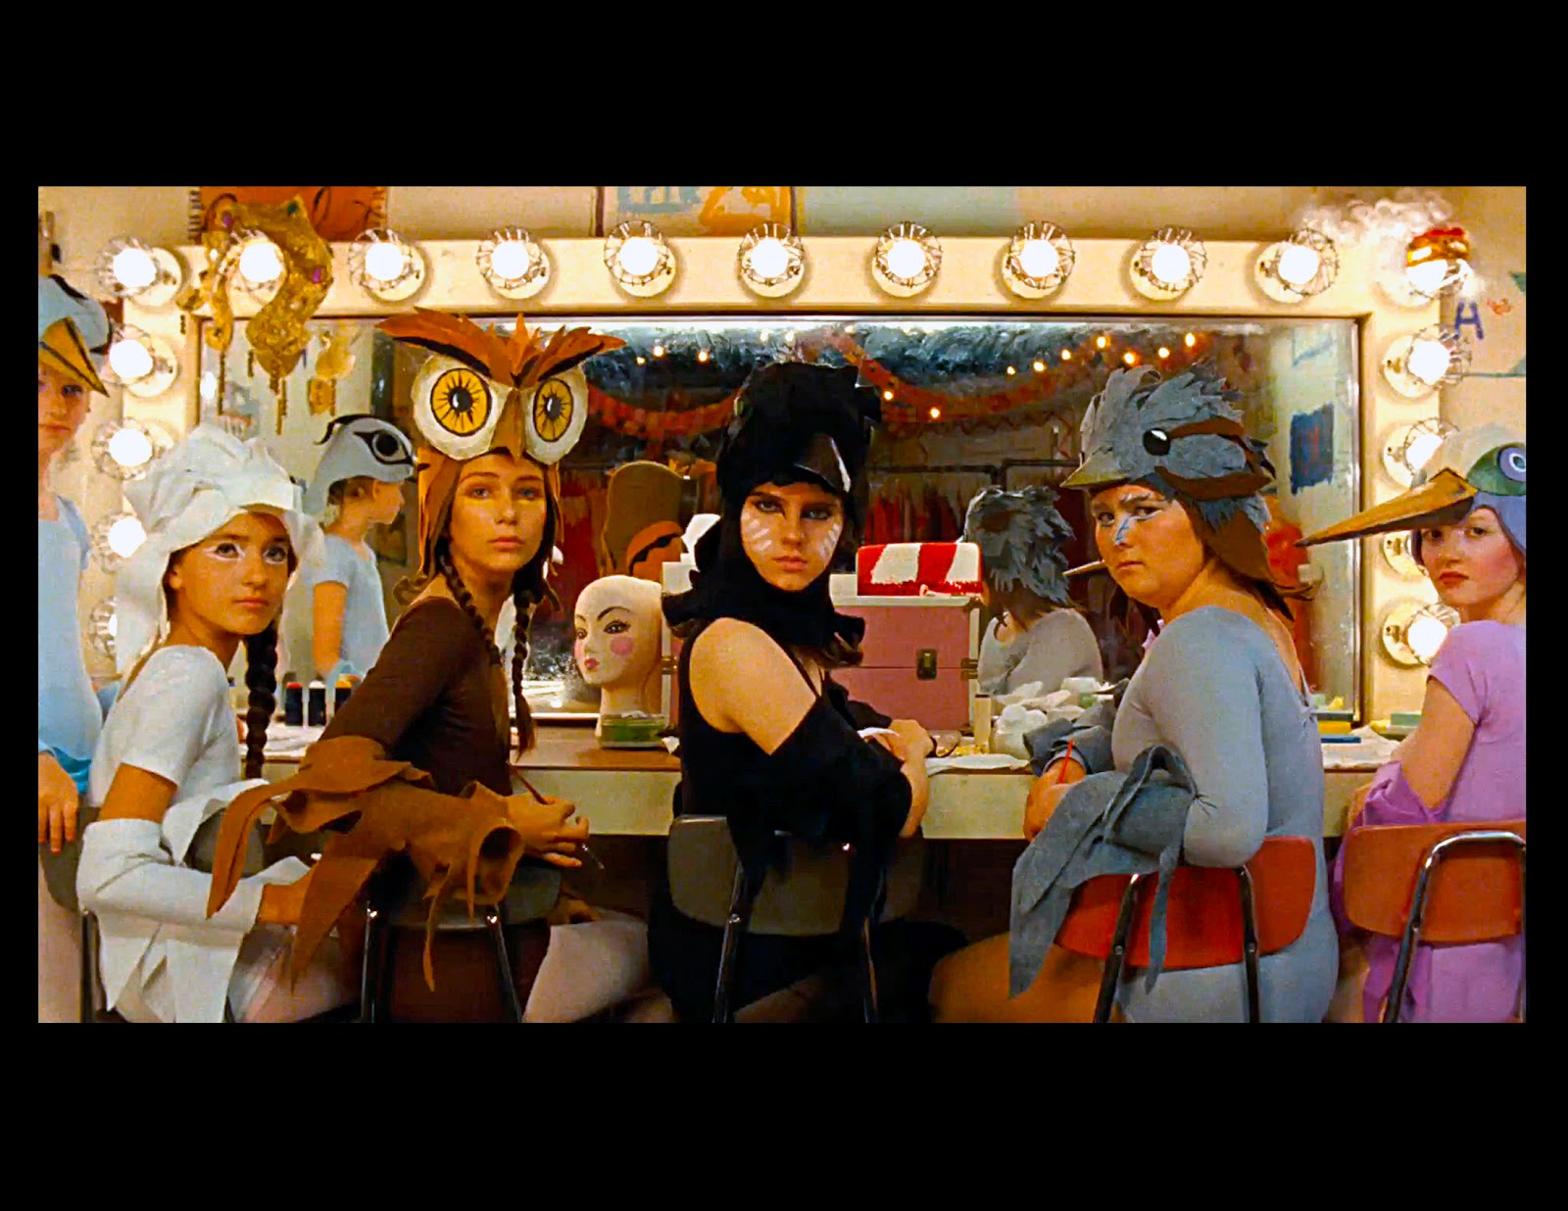

Slide 31
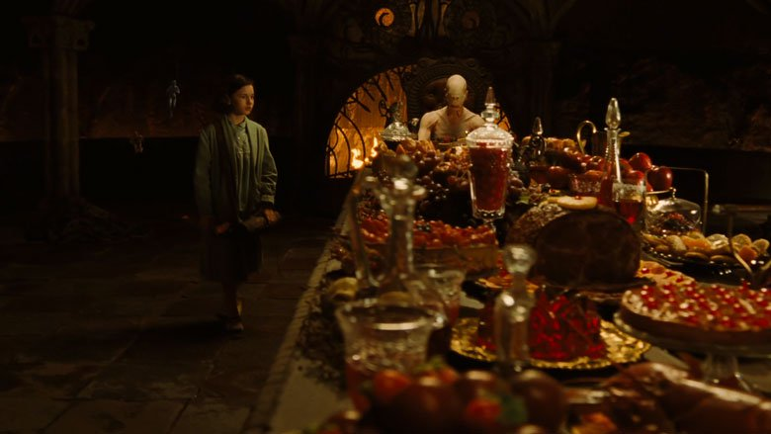

Slide 32
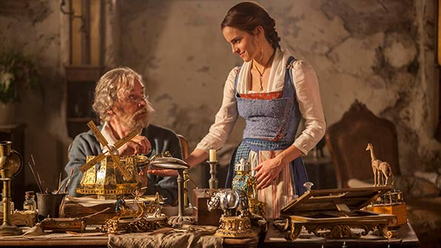

Slide 33
